Slide 1
Fundamentals of Programming
Lab Lecture #3
2022
Computer Science & Engineering Program
The School of EE & Computing
Adama Science & Technology University

Slide 2
I/O statements and functions Practice
  Case Study: Taxi Fare Change
  Formatting Number for Program Output
  Casting Operator
  Case Study: Buying Pizza
  General Problems(Maths and Physics)
  Assignment I: Rubber Ball

Slide 3
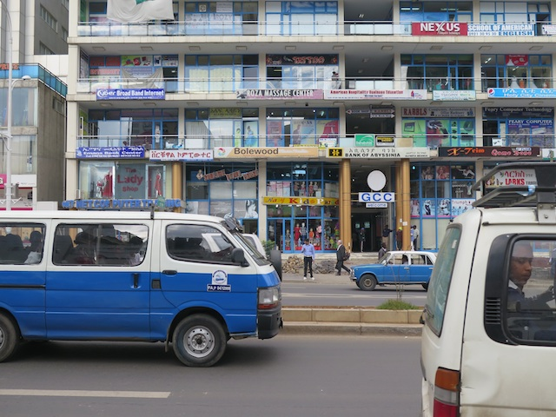
Case Study: Taxi Fare Change

Slide 4
Case Study: Taxi Changes
In Addis, to travel from Bole to Kazanchis the tariff is 2 birr and 70 cents. Suppose that the taxi assistant(conductor) don’t have any birr notes but only cents to return. So he wants the change to contain as many 50 cents as possible then 25 cents, 10 cents and 5 cents, in that order. We want our program to calculate the change, given the amount paid.

Slide 5
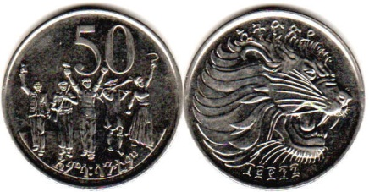
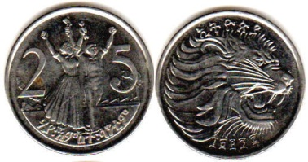
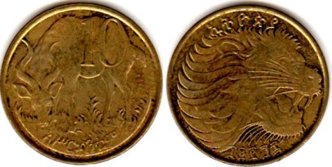
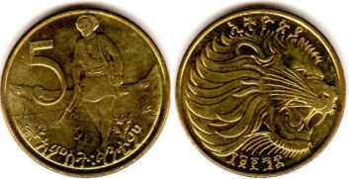
Step 1: Analyze the Problem
Input: Amount Paid
Output: Equivalent Change in 50 cents, 25 cents, 10 cents, and 5 cents.

Slide 6
Step 2: Develop a Solution
Suppose amount paid is 10 birr, therefore the change is 7 birr & 30 cents
    Change=7.30, So cents=730
    No of 50 cents=730/50=14
    Remaining Change=730 % 50=30
    No of 25 cents=30/25=1
    Remaining Change=30 % 25=5
    No of 10 cents=5/10=0
    Remaining Change=5 % 10=5
    No of 5 cents=5/5=1

Slide 7
Step 2: Develop a Solution(Detailed Algorithm)
  Prompt the user for input.
  Get input.
  Display the entered amount on the screen. (Echo)
  Calculate the Change in cents
  Print the Change in cents
  Compute and print the number of 50 cents.
  Calculate the remaining change.
  Compute and print the number of 25 cents.
  Calculate the remaining change.
  Compute and print the number of 10 cents.
  Calculate the remaining change.
  Print the remaining change(i.e. number of 5 cents)

Slide 8
Step 3: Coding
To calculate the equivalent change, the program performs calculations using the values of a fifty-cent, which is 50; a twenty-five-cent, which is 25; a ten-cent, which is 10 .
  Because these data are special and the program uses these values more than once, it makes sense to declare them as named constants.
  Using named constants also simplifies later modification of the program

Slide 9
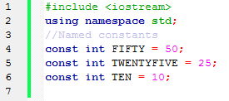
Step 3: Coding
Write a C++ program to solve the problem
    Use the following constants in your program
    Use variables where necessary
Modify the program to work for payments made for two or more people

Slide 10

Formatting Numbers for Program Output
The field width manipulator must be included for each value in the data stream sent to cout
Other manipulators remain in effect until they are changed
iomanip header file must be included to use manipulators requiring arguments

Slide 11
Formatting Number for Program Output
Test the format manipulators using a C++ program
Manipulators | Number | Display | Comments
setw(2) | 3 | | 3| | Number fits in the field.
setw(2) | 43 | |43| | Number fits in the field.
setw(2) | 143 | |143| | Field width is ignored.
setw(2) | 2.3 | |2.3| | Field width is ignored.
setw(5) fixed setprecision(2) | 2.366 | | 2.37| | Field width of five with two decimal digits.

Slide 12
Formatting Number for Program Output
Test the format manipulators using a C++ program
cout << "|" << setw(10) << fixed
<< setprecision(3) << 25.67 << "|";
Manipulators | Number | Display | Comments
setw(5) fixed setprecision(2) | 42.3 | |42.30| | Number fits in the field with the specified precision. Note that the decimal point takes up one location in the field width.
setw(5) setprecision(2) | 142.364 | |1.4e+002| | Field width is ignored, and scientific notation is used with the setprecision manipulator.
setw(5) fixed setprecision(2) | 142.364 | |142.36| | Field width is ignored, but precision specification is used. The setprecision manipulator specifies the number of fractional digits.
setw(5) fixed setprecision(2) | 142.366 | |142.37| | Field width is ignored, but precision specification used. The setprecision manipulator specifies the number of fractional digits. (Note the rounding of the last decimal digit.)
setw(5) fixed setprecision(2) | 142 | | 142| | Field width is used; fixed and setprecision manipulators are irrelevant because the number is an integer that specifies the total number of significant digits (integer plus fractional digits).

Slide 13
Formatting Number for Program Output
setiosflags manipulator: Allows additional formatting:
  Right or left justification
  Fixed display with 6 decimal places
  Scientific notation with exponential display
  Display of a leading + sign
Parameterized manipulator: One which requires arguments, or parameters

Slide 14
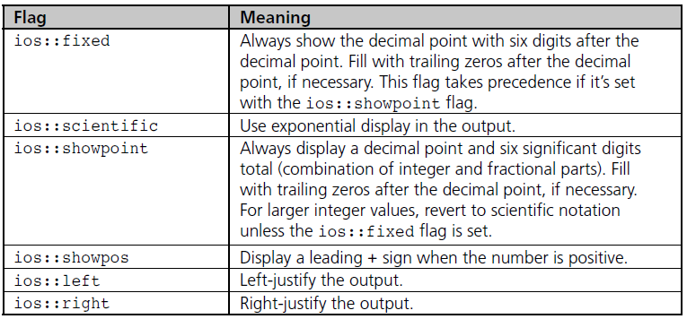

Formatting Number for Program Output

Slide 15
Formatting Number for Program Output
Manipulators can also be set using the ostream class methods
Separate the cout object name from the method name with a period
Example:
  cout.precision(2)

Slide 16
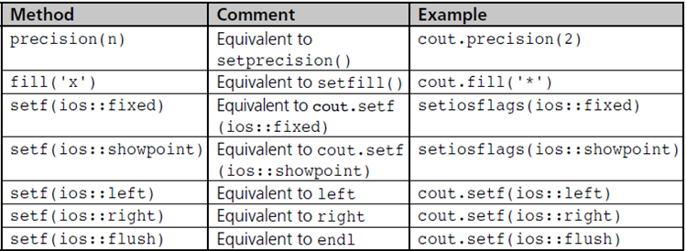
Formatting Number for Program Output

Slide 17
Cast Operator
Cast operator: A unary operator that forces the data to the desired data type
Compile-time cast
  Syntax: dataType (expression)
  Example: int(a+b)

Slide 18
Cast Operator
Run-time cast: The requested conversion is checked at run time and applied if valid
  Syntax:
staticCast<data-type> (expression)
  Example:
staticCast<int>(a*b)

Slide 19
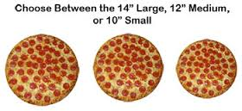
Case Study: Buying Pizza
The large “economy” size of an item is not always a better buy than the smaller size.
  This is particularly true when buying pizzas.
  Pizza sizes are given as the diameter of the pizza in inches.

Slide 20
Case Study: Buying Pizza
However, the quantity of pizza is determined by the area of the pizza
  Most people cannot easily estimate the difference in area between a ten-inch pizza and a twelve-inch pizza
  So cannot easily determine which size is the best buy—that is, which size has the lowest price per square inch.

Slide 21
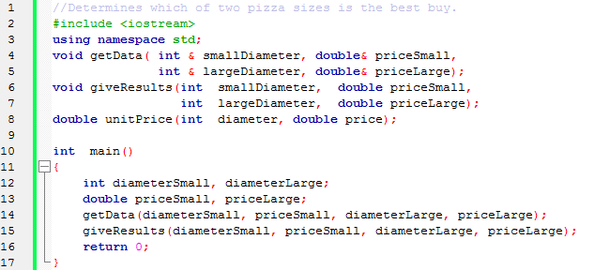
Case Study: Buying Pizza
Build, Run and Test the following program
Understand the logic

Slide 22
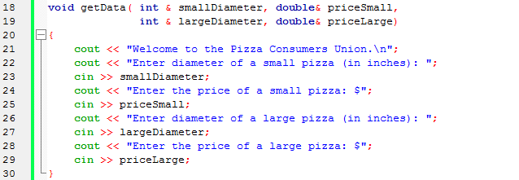
Case Study: Buying Pizza

Slide 23
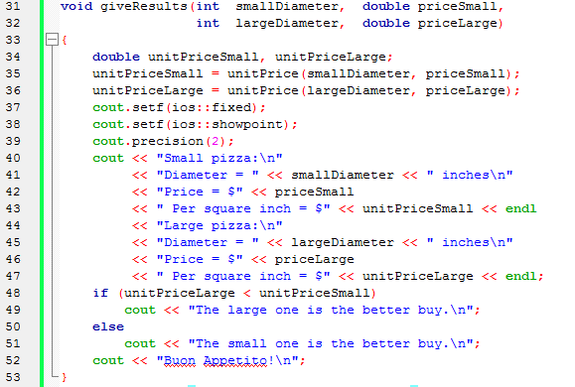
Case Study: Buying Pizza

Slide 24
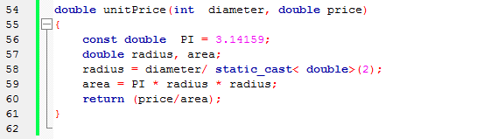
Case Study: Buying Pizza

Slide 25
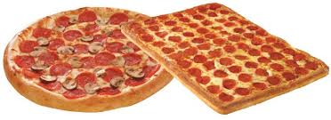
Case Study: Buying Pizza
Suppose that restaurants offer both round pizzas and rectangular pizzas.
The code is on the next slides
Note that the function name unitPrice has been overloaded so that it applies to both round and rectangular pizzas.
Build, Run and Test the Program

Slide 26
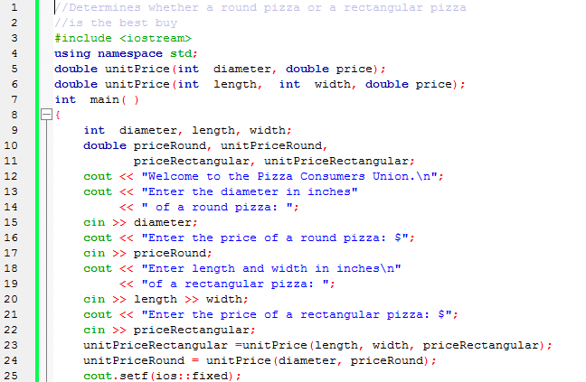
Case Study: Buying Pizza

Slide 27
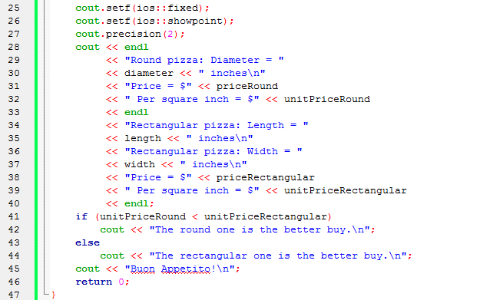
Case Study: Buying Pizza

Slide 28
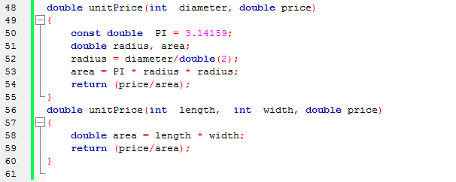
Case Study: Buying Pizza

Slide 29
General Problems
Develop a calculator program using function (use five functions add (), multiply (), divide (), subtract () and module ().

Slide 30
General Problems
Write a C++ program to calculate and display the value of the slope of the line connecting two points with the coordinates (3,7) and (8,12).
After verifying the output your program produces, modify it to determine the slope of the line connecting the points (2,10) and (12,6).

Slide 31
General Problems
What will happen if you use the points (2,3) and (2,4)
Change its output to this:
  The value of the slope is xxx.xx
  The xxx.xx denotes placing the calculated value in a field wide enough for three places to the left of the decimal point and two places to the right of it.

Slide 32
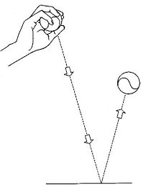
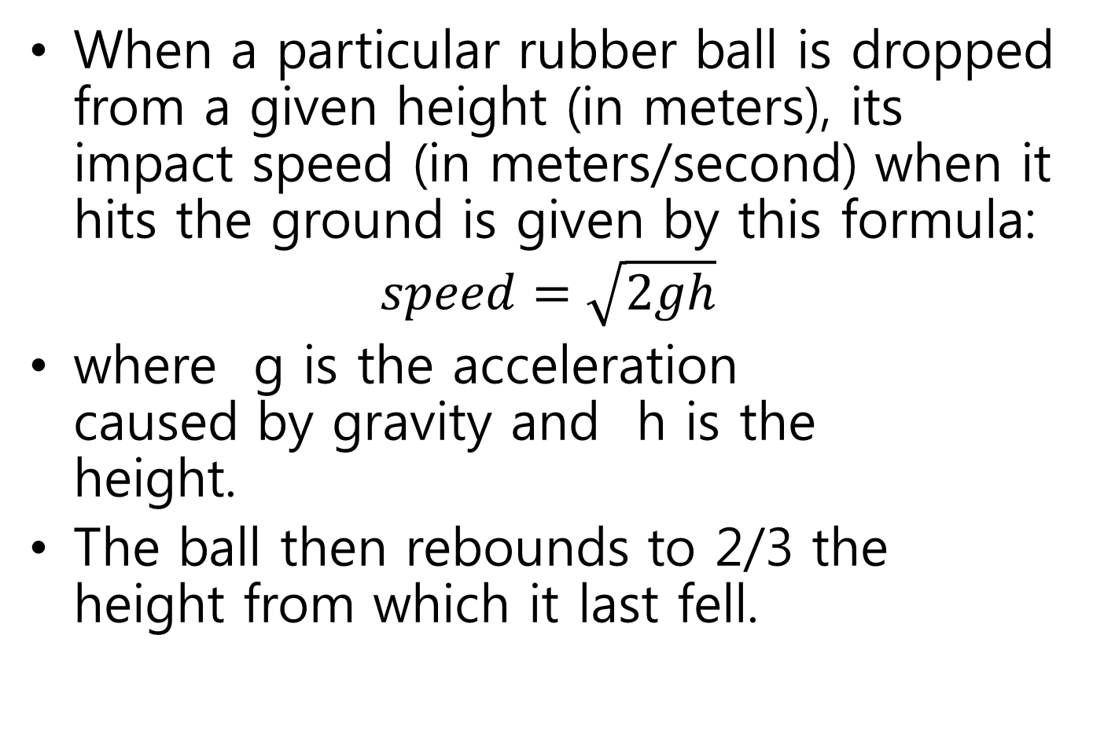
Assignment #1
When a particular rubber ball is dropped from a given height (in meters), its impact speed (in meters/second) when it hits the ground is given by this formula:
$$speed=\sqrt{2gh}$$
where g is the acceleration caused by gravity and h is the height.
The ball then rebounds to 2/3 the height from which it last fell.

Slide 33
Assignment #1 …
Write, test, and run a C++ program that calculates and displays the impact speed of the first three bounces and the rebound height of each bounce.
Test your program by using an initial height of 2.0 meters.
Run the program twice, and compare the results for dropping the ball on Earth (g = 9.81 m/s²) and on the moon (g = 1.67 m/s²).

